Slide 1
Text2Relap v. 2.0.0

Slide 2
General
Now written in Excel VBA instead of MATLAB
Faster than starting MATLAB and waiting for script to run
Opens up new possibilities to interact with final output
Improved input error checking
Easier to maintain and improve

Slide 3
New feature: Add components
Add most common components
For Pipes, possible to add many segments at once

Slide 4
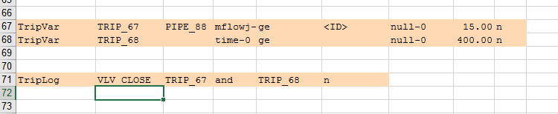
New feature: Define trips
Define trips without using include files
Close valve after 400 seconds if flow in PIPE_88 > 15 kg/s

Slide 5
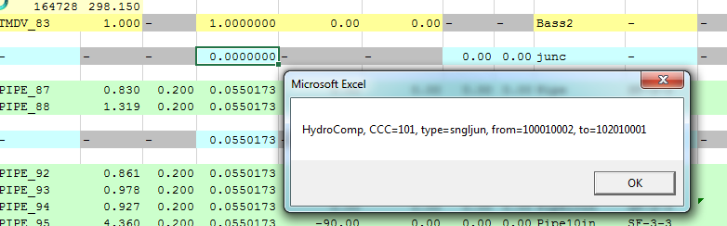
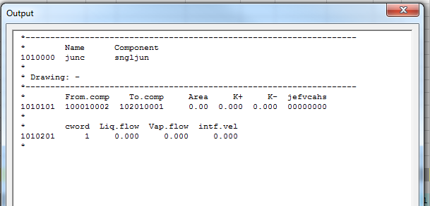
New feature: Prope output
See output without generating a input file

Slide 6
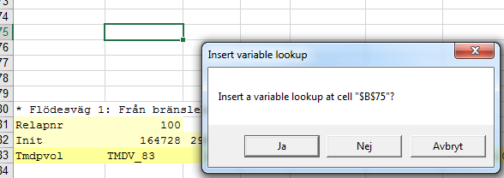
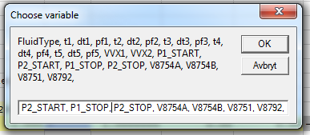
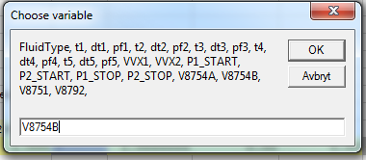
New feature: Add tripvar
Inputbox to more easily see available variables from runMatrix

Slide 7
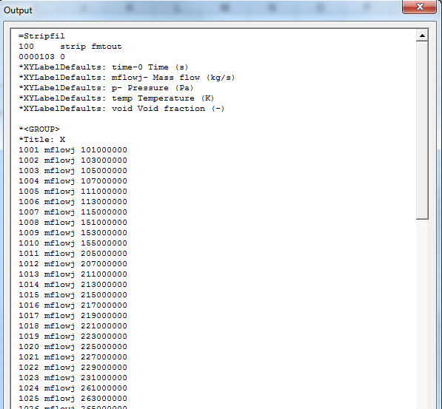

New feature: Generate strip request file
Generate a strip request file directly

